Slide 1


PUBLIC TELECOMMUNICATION POLICIES AND NATIONAL COVERAGE IN NICARAGUA
Access
Quality Services
Fair prices
ICT empowerment
Establish and develop a policy for information and communication technologies that fosters the development of infrastructures and technological instruments for our Nicaraguan families.
Advance with the expansion of bandwidth in high-speed internet service and its access throughout the country.
Develop new specific regulations and studies that allow the updating and development of telecommunications for the benefit of our Nicaraguan families.
Notes:
Our public policies place us in a privileged position to promote information and communication technologies, reduce the digital gap and access telecommunications at affordable prices for the entire population, through the development of infrastructures and technological instruments.

Slide 2
PUBLIC TELECOMMUNICATION POLICIES AND NATIONAL COVERAGE IN NICARAGUA
YEAR | Investment in Dollars
2007
2008 | $160,000,000
2009 | $178,000,000
2010 | $99,000,000
2011 | $121,000,000
2012 | $117,000,000
2013 | $109,000,000
2014 | $143,000,000
2015 | $137,000,000
2016 | $264,000,000
2017 | $121,000,000
2018 | $145,000,000
2019 | $150,000,000
In the period from 2007 to 2020 we have obtained the highest growth in Telecommunications.
Thanks to the Policies adopted by our good Government, we have promoted the development of telecommunications, guaranteeing an environment of trust in the sector and allowing companies to invest in continuing to create Telecommunications access for Nicaraguan families.
Total: $1,744,000.000
Notes:
In the period from 2007 to 2020, the telecommunications sector in Nicaragua presented one of the greatest growths in the history of our country, thanks to the policies adopted by the Government of Reconciliation and National Unity (GRUN) and TELCOR as the Regulating entity in charge of promoting the development of telecommunications and guaranteeing an environment of trust in the sector, has allowed companies to invest approximately $ 150,000 million in the development of their networks in recent years in order to expand their coverage areas. These investments are mainly oriented to fixed telecommunications infrastructure (fiber optics), wireless, data networks and fixed telephony; due to the growing demand for multimedia services that have led to the need to increase bandwidth to enable the population to inform, train, send photos, videos, entertain themselves and use other applications.
This increase in Investments has allowed telecommunications operators in Nicaragua to transform and no longer only offer a service, but also offer double and triple play options to their clients. In addition, many offer Internet access services, commercialization of satellite television services, subscription television, microwave links, VSAT earth stations, import of equipment, voice messages, short message service, information services, basic telephony, data transmission, etc.

Slide 3
PUBLIC TELECOMMUNICATION POLICIES AND NATIONAL COVERAGE IN NICARAGUA
YEAR | Fixed telephony users | Mobile phone users | Number of Fixed Internet Connections | Number of Mobile Internet Connections | Subscription TV Users
2007 | 257,588 | 2,503,051
2008 | 254,438 | 3,108,854 | 49,312 | 521
2009 | 254,686 | 3,344,563 | 94,949 | 7,752 | 153,016
2010 | 258,325 | 3,962,247 | 97,307 | 21,056 | 178,153
2011 | 287,618 | 4,823,534 | 116,681 | 26,719 | 198,765
2012 | 299,123 | 5,851,723 | 143,883 | 31,751 | 217,610
2013 | 324,917 | 6,808,930 | 172,389 | 290,462 | 239,271
2014 | 339,629 | 7,069,251 | 145,218 | 753,701 | 266,904
2015 | 354,017 | 7,265,542 | 164,771 | 1,126,740 | 294,914
2016 | 366,636 | 7,745,512 | 177,024 | 1,443,171 | 383,834
2017 | 375,856 | 7,304,701 | 181,838 | 2,369,527 | 291,567
2018 | 325,821 | 6,240,345 | 192,413 | 2,432,921 | 296,485
2019 | 228,782 | 5,905,956 | 216,618 | 2,672,375 | 300,015
2020 | 235,401 | 5,961,569 | 237,048 | 3,306,666 | 304,214
Notes:
Number of fixed internet connections: almost a million people.
This increase in Investments has allowed:
That telecommunications operators in Nicaragua have been transforming themselves.
New telecommunications operators entered the Nicaraguan market, where TELCOR granted an operating concession in 2010 to YOTA as an Internet provider and in 2013 to Xinwei as an operator of cellular, data transmission, Internet and basic telephony services.
This revitalization of the telecommunications market allows for a greater offer of services, expansion of coverage in unattended areas and competitive rates on services for the benefit of Nicaraguans.

Slide 4

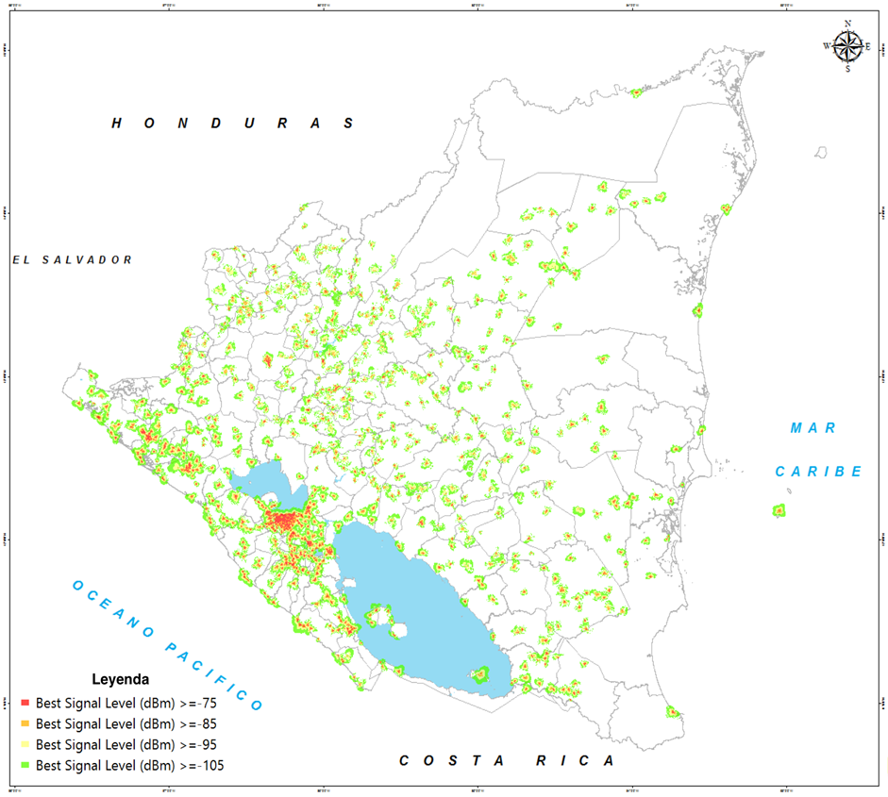
Cellular Telephone Coverage 3G Operators.

Slide 5
PUBLIC TELECOMMUNICATION POLICIES AND NATIONAL COVERAGE IN NICARAGUA
Broadband - Access - Infrastructure
The Broadband Program was born in 2016.
Investment of 50 million dollars.
IDB and South Korea financing.
Objective: Expand the fiber optic infrastructure, modernize the Nicaraguan regulatory framework and empower the use of Information Technologies.
We are finalizing the deployment of fiber optics with a total of 2,580 km, benefiting 93 municipalities in Nicaragua.
We achieved 60.78% of national broadband infrastructure coverage.
It is estimated that around 4.9 million people have the possibility of accessing telecommunications services.

Slide 6
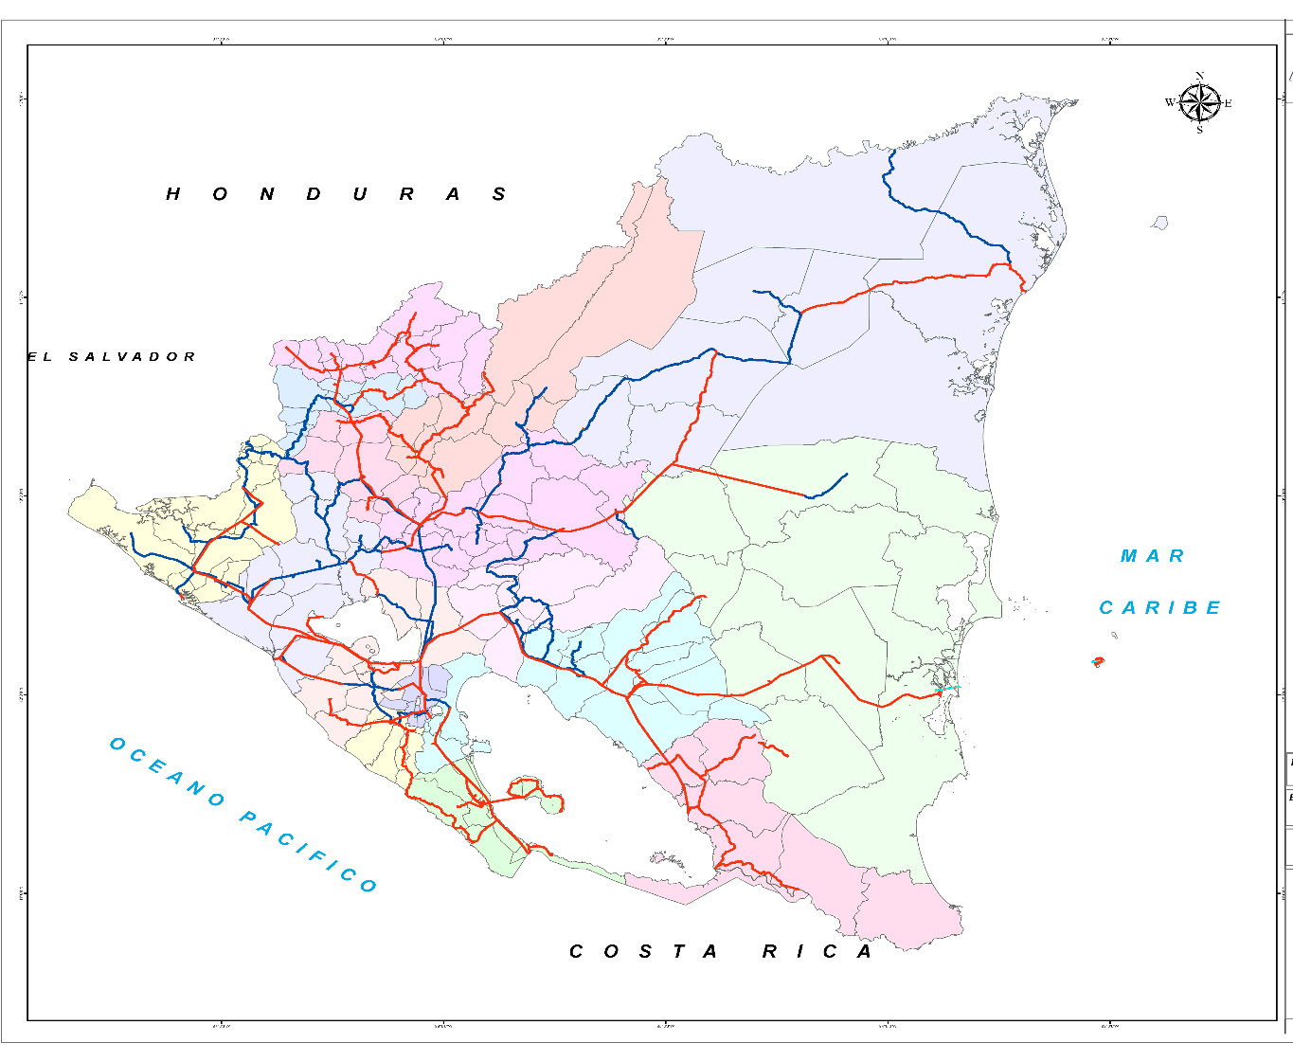
Fiber Optic Coverage of the State of Nicaragua.

Slide 7
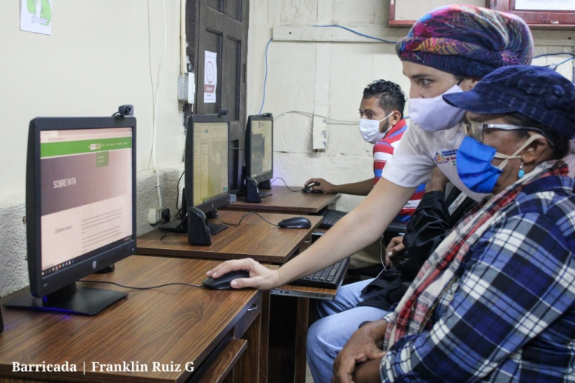
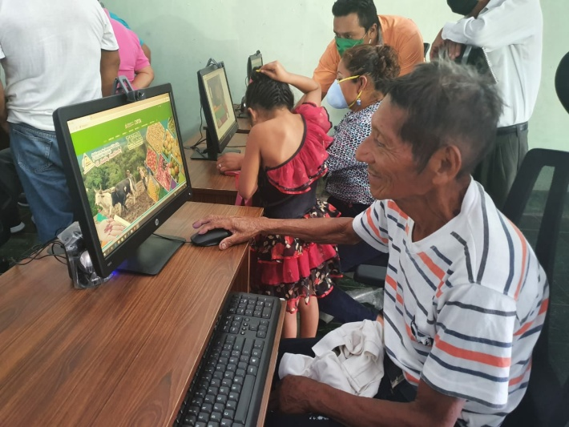
PUBLIC TELECOMMUNICATION POLICIES AND NATIONAL COVERAGE IN NICARAGUA
Broadband - Access - ICT Empowerment
We are contributing with technological equipment and connectivity:
100 Telecentres whose beneficiary is: The Nicaraguan Institute of Agricultural Technology.
Investment: C$21,000,000.00
Objective: Promote the use of information technologies and train our producers to improve efficiency and productivity.
Approximate beneficiaries: 4,500 producers

Slide 8
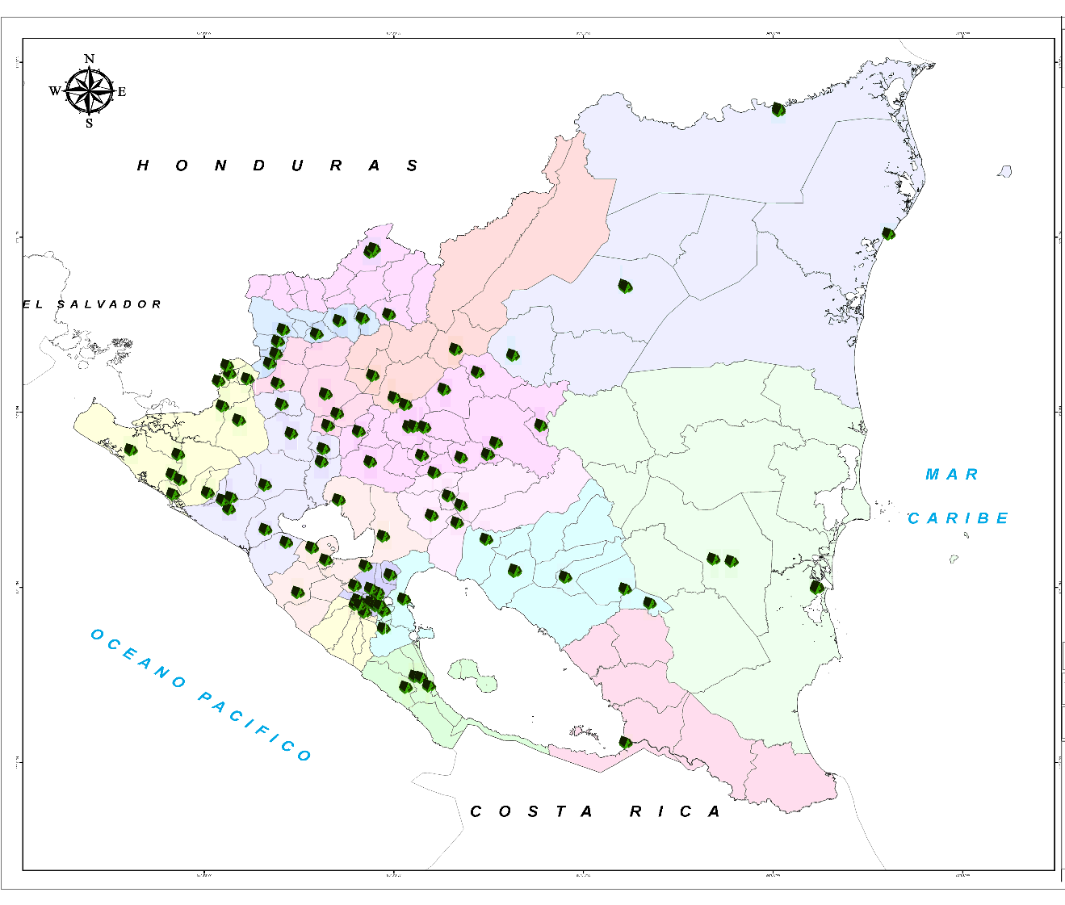
Coverage of Beneficiary Sites of the Nicaraguan Institute of Agricultural Technology.

Slide 9
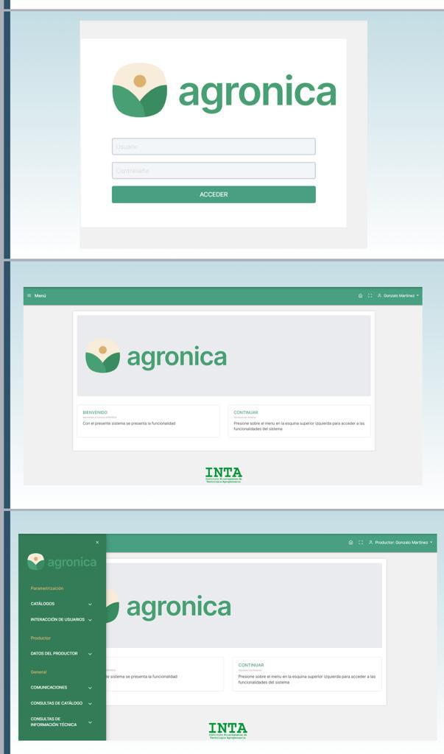
PUBLIC TELECOMMUNICATION POLICIES AND NATIONAL COVERAGE IN NICARAGUA
Broadband - Access - Empowerment Information and Communication Technologies
DEVELOPMENT OF TECHNOLOGICAL APPLICATION - Technological Institute of Agriculture.
OBJECTIVE:
Promote the use of information technology and connectivity through a technological application that improves the productivity and efficiency of our farmers.
Investment: C$10,250.00.00 córdobas.
Beneficiaries: 4,500 producers.

Slide 10
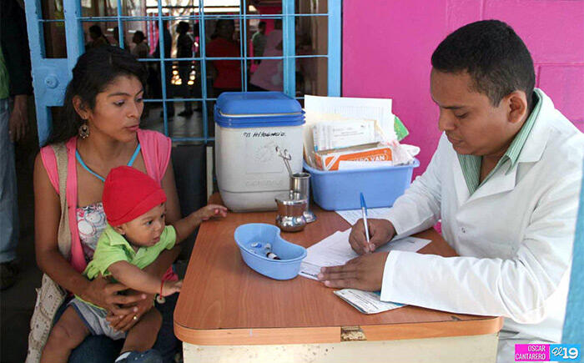
PUBLIC TELECOMMUNICATION POLICIES AND NATIONAL COVERAGE IN NICARAGUA
Broadband - Access - Empowerment Information and Communication Technologies
We are contributing technological equipment and connectivity to:
149 Health Centers whose beneficiary is: Ministry of Health.
Investment: C$ 48,203.00.00
Objective: Promote the use of information technologies in our health centers to improve efficiency and care for our Nicaraguan families.

Slide 11
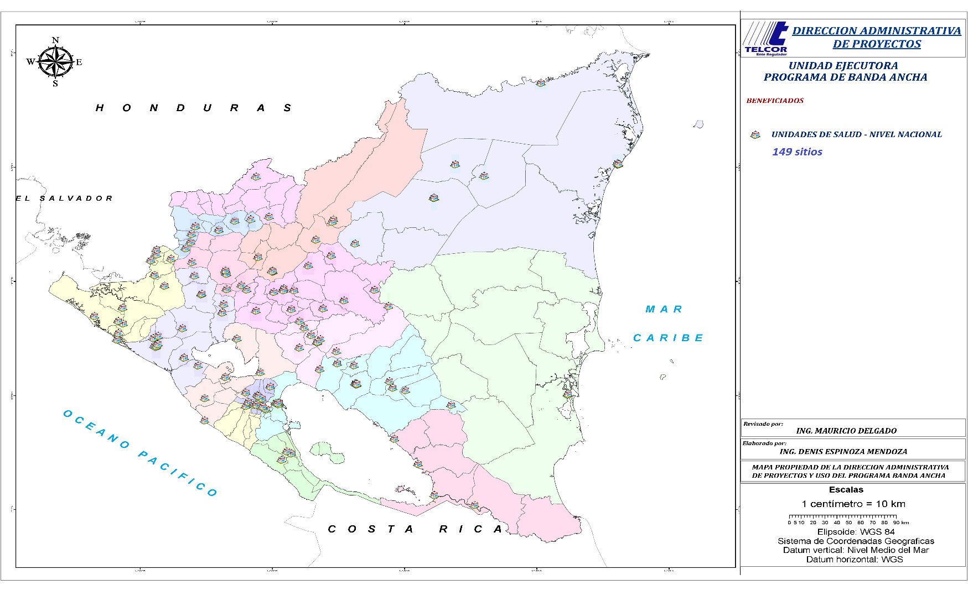
Coverage of Beneficiary Sites of the Ministry of Health.

Slide 12
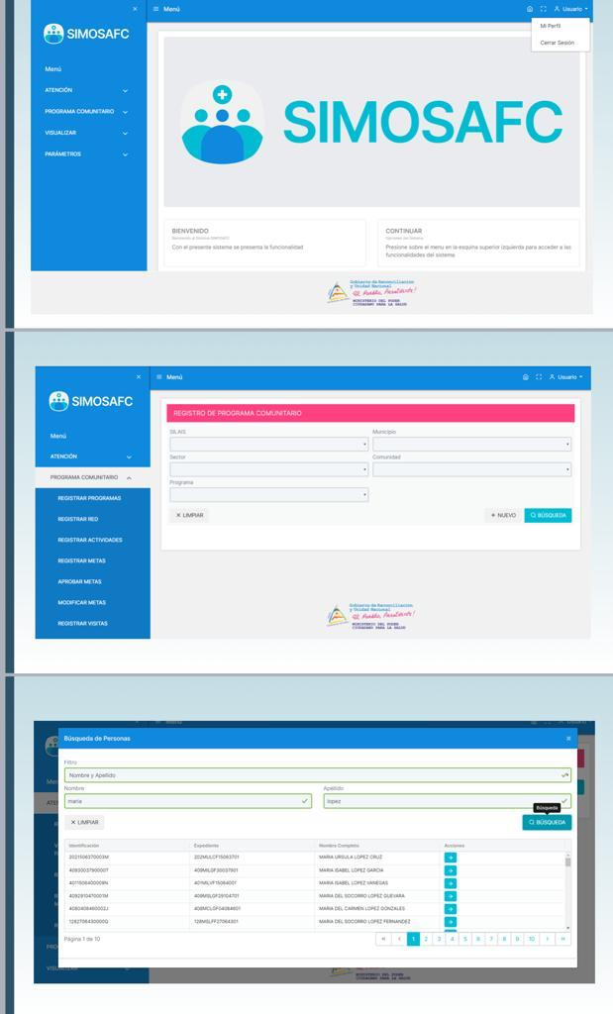
PUBLIC TELECOMMUNICATION POLICIES AND NATIONAL COVERAGE IN NICARAGUA
Broadband - Access - Empowerment Information and Communication Technologies
DEVELOPMENT OF TECHNOLOGICAL APPLICATION - MINSA
OBJECTIVE:
The design of innovative applications or services related to diagnoses, treatment and electronic health records that use connectivity to reduce maternal and child mortality.
Investment: C$ 10,250,000.00 córdobas
Beneficiaries: 7,000 doctors from health centers.

Slide 13
PUBLIC TELECOMMUNICATION POLICIES AND NATIONAL COVERAGE IN NICARAGUA
Infrastructure Program for the Caribbean Region - CARCIP
INFRASTRUCTURE - ACCESS
The CARCIP Program was born in 2018
Investment of 20.1 million dollars.
Financing: World Bank.
Objective: Expand the infrastructure of the Caribbean Coast and empower the use of ICT in the region.
We have connected 15 communities of the RACCN, RACCS and the department of Río San Juan with an investment of: C$ 119,700,000.00.
We are currently carrying out the deployment of a 115 km Fiber Optic section between El Rama - Kukra Hill and Laguna de Perlas in the RACCS that will benefit 5 communities.
Notes:
20 communities

Slide 14
PUBLIC TELECOMMUNICATION POLICIES AND NATIONAL COVERAGE IN NICARAGUA
Infrastructure Program for the Caribbean Region - CARCIP
INFRASTRUCTURE - ACCESS
We will be enabling Broadband Access Networks to communities located in the Waslala - Siuna - Rosita - Puerto Cabezas - Waspam sections, using fiber optic as the Broadband program as transportation. With an investment of: C$ 30,840,000.00, benefiting 32 communities in the Caribbean Zone.
This will allow Telecommunications access to our Nicaraguan families in the Caribbean Zone.
Notes:
52 comunidades

Slide 15
PUBLIC TELECOMMUNICATION POLICIES AND NATIONAL COVERAGE IN NICARAGUA
Infrastructure Program for the Caribbean Region - CARCIP
INFRASTRUCTURE - ACCESS - Empowerment of Information and Communication Technologies
We have enabled infrastructure and Internet access in 14 Health Units in Rural Areas of the Caribbean Coast, improving the health services provided to our Nicaraguan families. With an investment of: C$ 6,800,000.00 córdobas.
Mongallo | 6. Papaturro | 11. Sukatpin
2. Guayabo Central | 7. Wisconsi | 12. Yulu
3. Zinica #2 | 8. Santa Clara | 13. Maniwatla
4. Ocote Tuma | 9. Francia Sirpi | 14. Wasakin
5. Las Tatas | 10. Awastingni
Notes:
66 comunidades

Slide 16
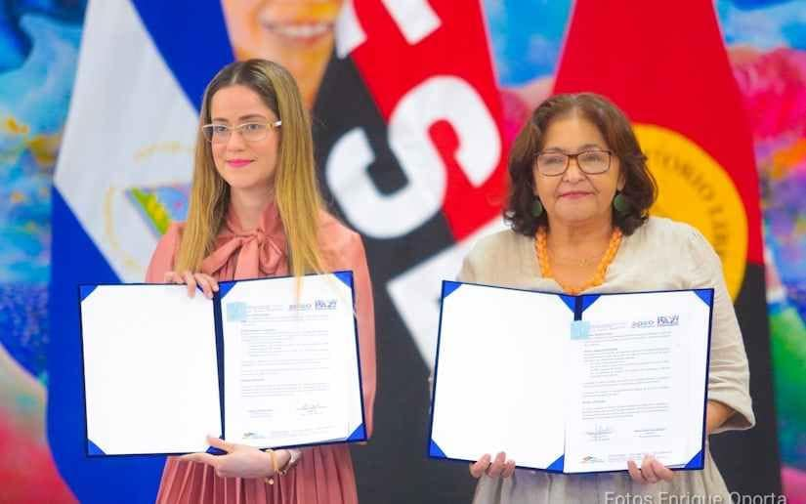
PUBLIC TELECOMMUNICATION POLICIES IN NICARAGUA AND NATIONAL COVERAGE
Infrastructure Program for the Caribbean Region - CARCIP
INFRASTRUCTURE - ACCESS - Empowerment of Information and Communication Technologies
We are starting the creation of Digital Classrooms in 5 schools in the Caribbean area through an inter-institutional effort between TELCOR and MINED with an investment of: C$ 7,000,000.00 córdobas, benefiting approximately 1,300 students and 52 teachers.
2 in Waslala
2 in Siuna
1 in El Tortuguero

Slide 17
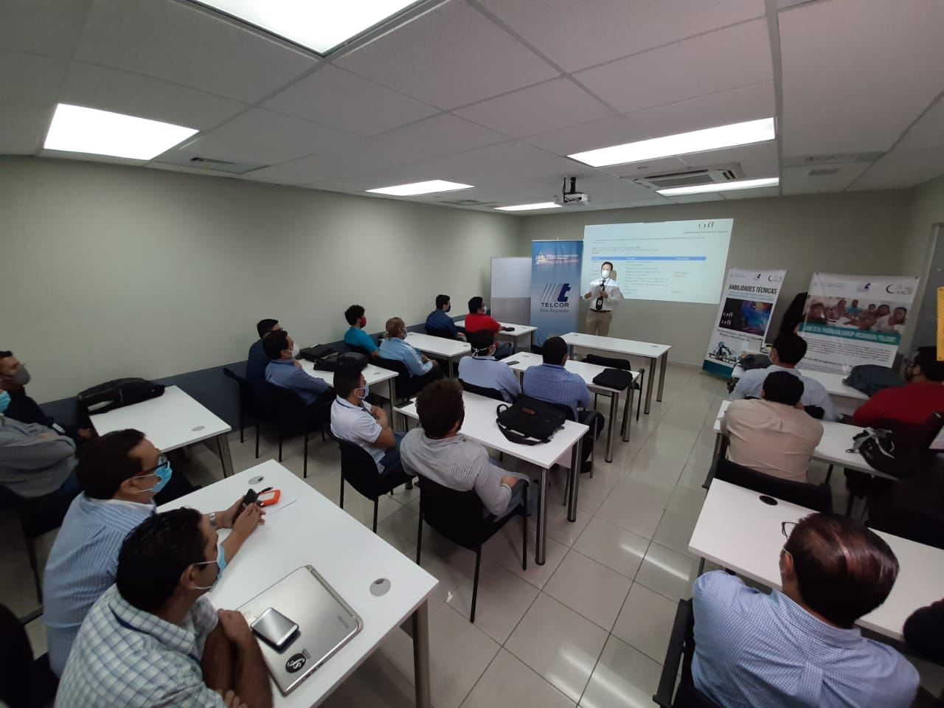
PUBLIC TELECOMMUNICATION POLICIES AND NATIONAL COVERAGE IN NICARAGUA
Infrastructure Program for the Caribbean Region - CARCIP
ACCESS - Empowerment of Information and Communication Technologies
We are conducting training and certifications in soft skills, (communication, negotiation and innovation); English skills and world-class technical certifications.
Objective: That our low-income youth can opt for better jobs.
Investment: C$ 53,221,000.00 córdobas.
Beneficiaries: 5,0000 Nicaraguan youth.

Slide 18
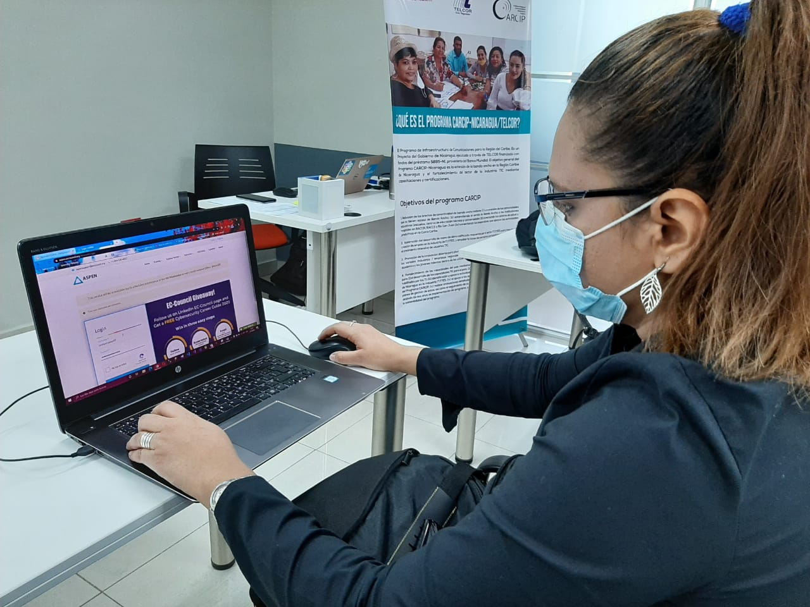
PUBLIC TELECOMMUNICATION POLICIES AND NATIONAL COVERAGE IN NICARAGUA
Infrastructure Program for the Caribbean Region - CARCIP
ACCESS - Empowerment of Information and Communication Technologies
The following goals have currently been reached:
  ENGLISH COURSES:
  Trained: 1,294 young people.
  In training ending in December 2020: 1,600 people.
  SOFT SKILLS:
  Trained: 1,710 young people.
  TECHNICAL CERTIFICATIONS:
  Trained: 270 young people.
  In training ending in December 2020: 780 young people.
For an execution of 81.8% of the indicator of training 5,000 young people.

Slide 19
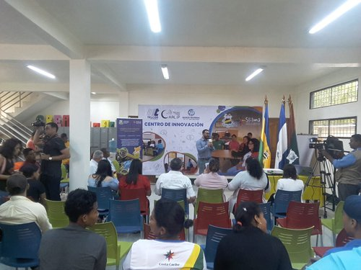
PUBLIC TELECOMMUNICATION POLICIES AND NATIONAL COVERAGE IN NICARAGUA
Infrastructure Program for the Caribbean Region - CARCIP
ACCESS - Empowerment of Information and Communication Technologies
INNOVATION CENTER FACILITIES:
The fundamental objective of the Innovation Centers is to create a physical space with technological equipment, furniture and technical assistance, which serves the population as an instrument to incentivize and promote innovation through the use of information technologies, to generate innovative solutions to daily problems in matters of productivity, health and education.

Slide 20
PUBLIC TELECOMMUNICATION POLICIES AND NATIONAL COVERAGE IN NICARAGUA
Infrastructure Program for the Caribbean Region - CARCIP
ACCESS - Empowerment of Information and Communication Technologies
We have inaugurated 2 Innovation centers in Bilwi and Bluefields.
We contributed with furniture, technological equipment and connectivity, with an investment of: C$ 14,650,600.00 córdobas for the benefit of our young people.
We are about to start the inaugurations of four additional innovation centers in:
- Unan University - León: 3,000 young people benefited.
- BICU University of Bonanza: 1,200 young people benefited.
- URACCAN University of Siuna: 2,500 young people benefited.
- FAREM University of Estelí: 1,500 young people benefited.
With an Investment of: C$ 8,100,000. córdobas.

Slide 21
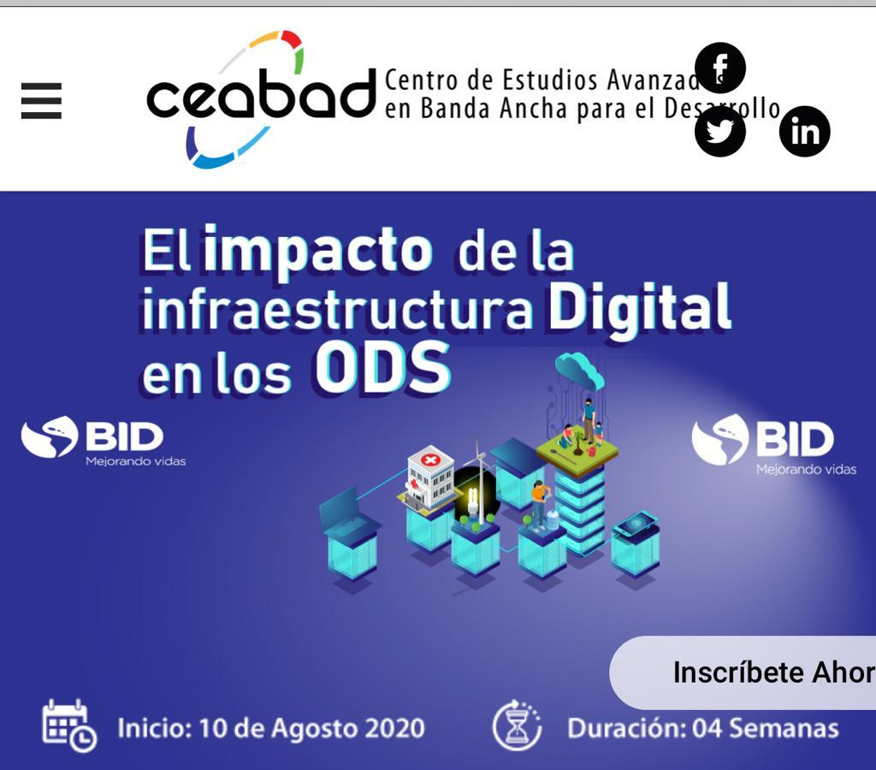
PUBLIC TELECOMMUNICATION POLICIES AND NATIONAL COVERAGE IN NICARAGUA
CEABAD - CENTER FOR ADVANCED STUDIES OF BROADBAND
Empowerment of Information and Communication Technologies.
Actions:
-Installation of the Center for Advanced Broadband Studies for Development (CEABAD) in conjunction with South Korea in 2014.
This center has trained 1,556 employees face-to-face and 1,408 officials virtually on information technology issues and global trends in telecommunications.

Slide 22
"The development of Information and Communication Technologies (ICT), particularly Broadband, contribute to the unity of Latin American and Caribbean peoples."
Comandante President Daniel Ortega Saavedra
Closing of the Regional Forum "Connectivity for All" in 2016

